Slide 1
LIBRARY MANAGEMENT SYSTEM

Slide 2
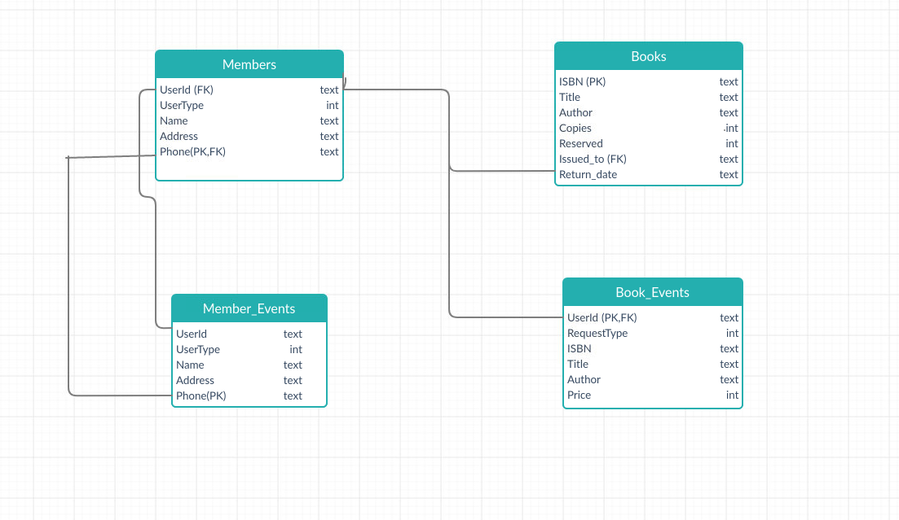
Database Architecture

Slide 3
ACCESS RIGHTS FOR DIFFERENT ACTORS
 | Member_Events | Book_Events | Member | Book
Library Staff | Read/Write | Read/Write | Read/Write | Read/Write
User | Read/Write | Read/Write | Read | Read
Supplier | Read/Write | Read/Write | Read | Read

Slide 4
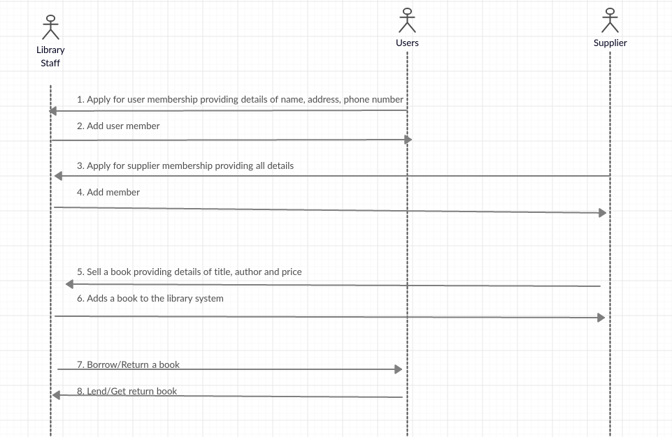
Sequence diagram

Slide 5
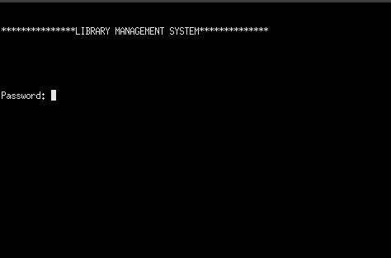
Login Prompt

Slide 6
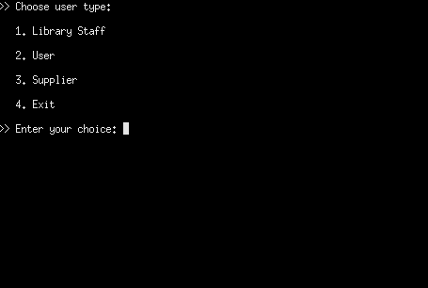
Prompt for USERTYPE

Slide 7
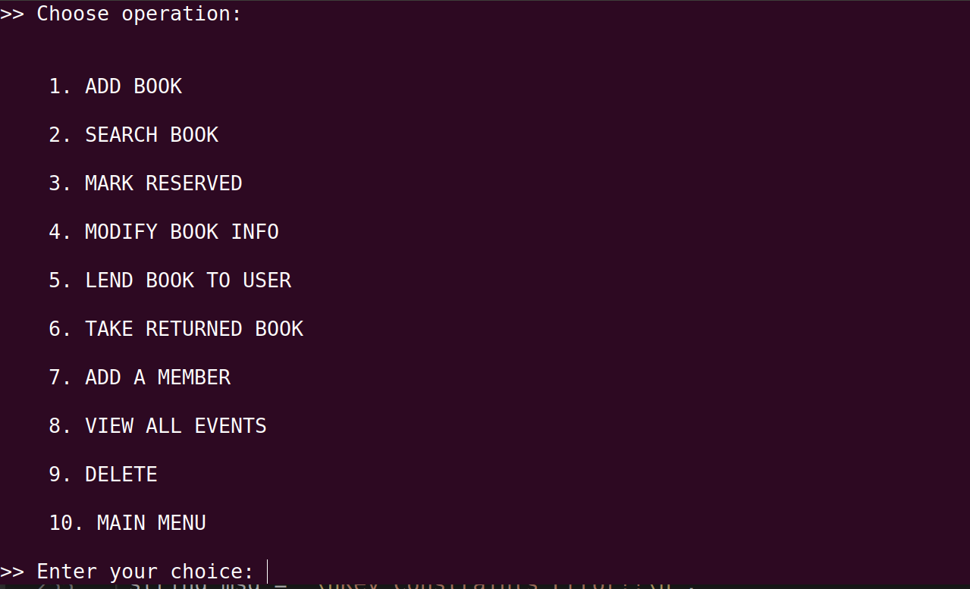
USERTYPE 1: Library Staff Operations

Slide 8
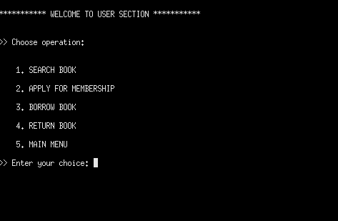
USERTYPE 2: User Operations

Slide 9
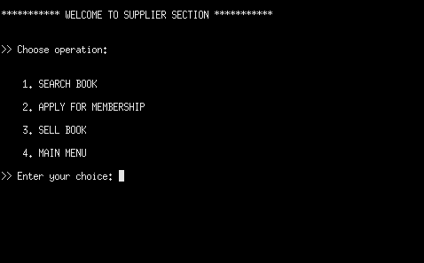
USERTYPE 3: Supplier Operations

Slide 10
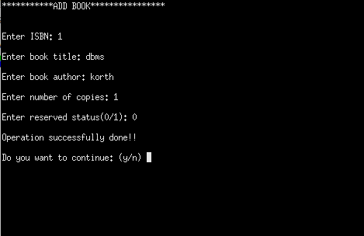
Copy Book Operation

Slide 11
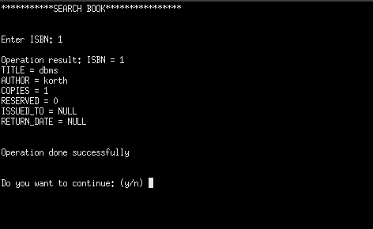
Search Book Operation

Slide 12
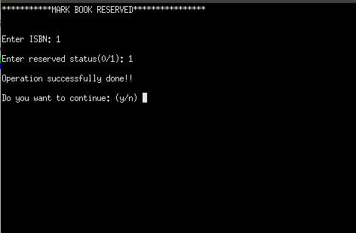
Mark Reserved Operation

Slide 13
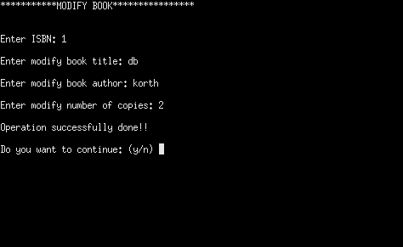
Modify Book Operation

Slide 14
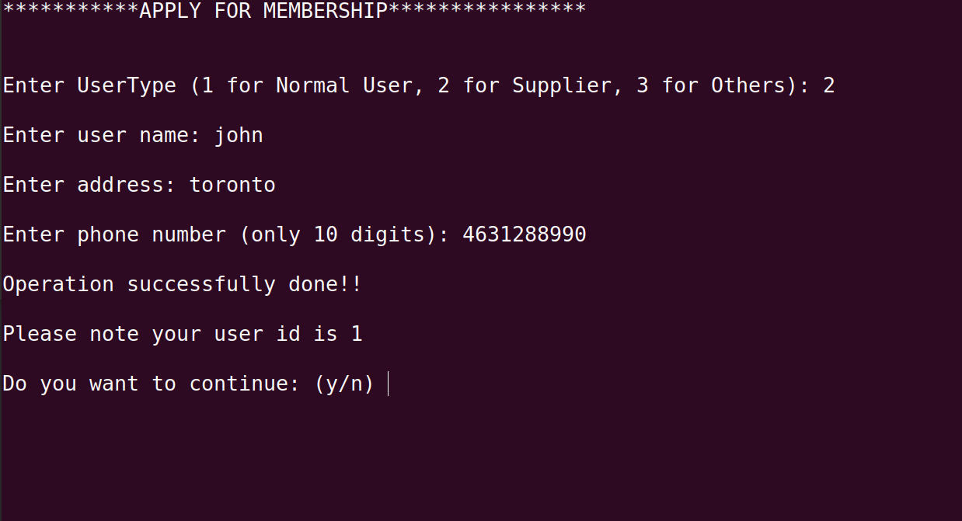
APPLY FOR MEMBERSHIP Operation

Slide 15
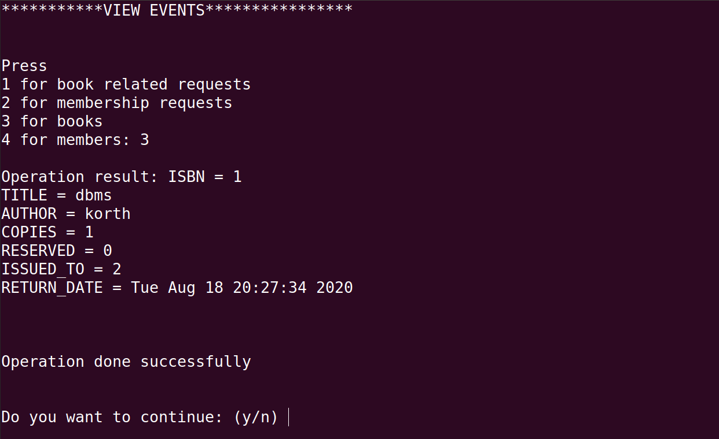
View Events Operation

Slide 16
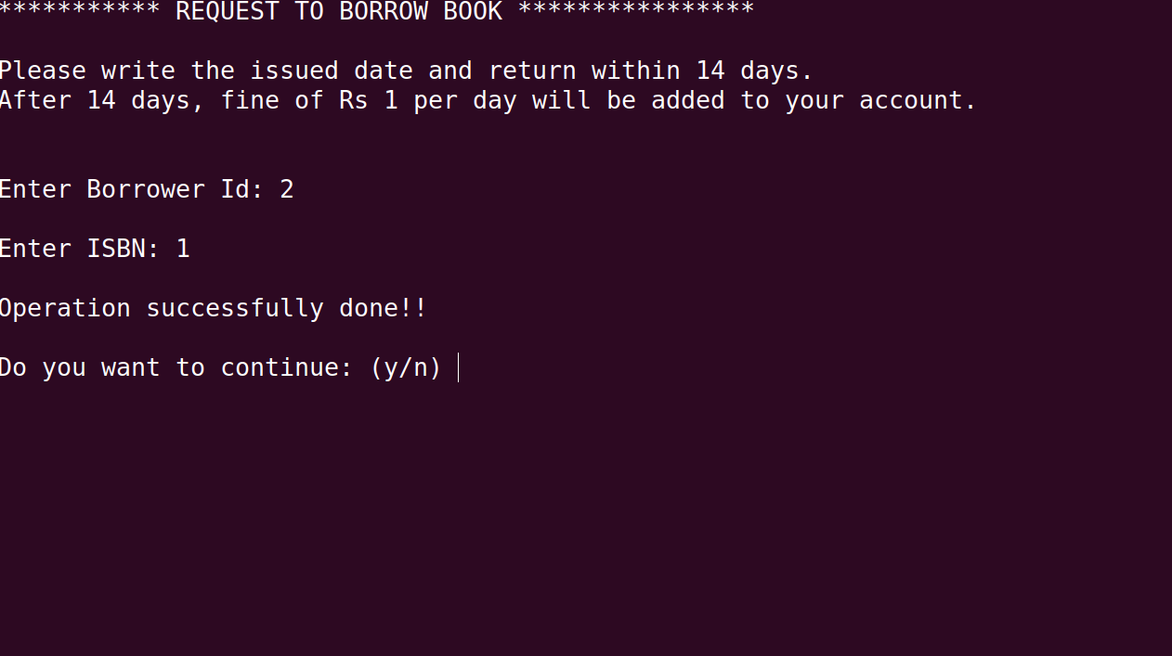
Borrow Book Operation

Slide 17
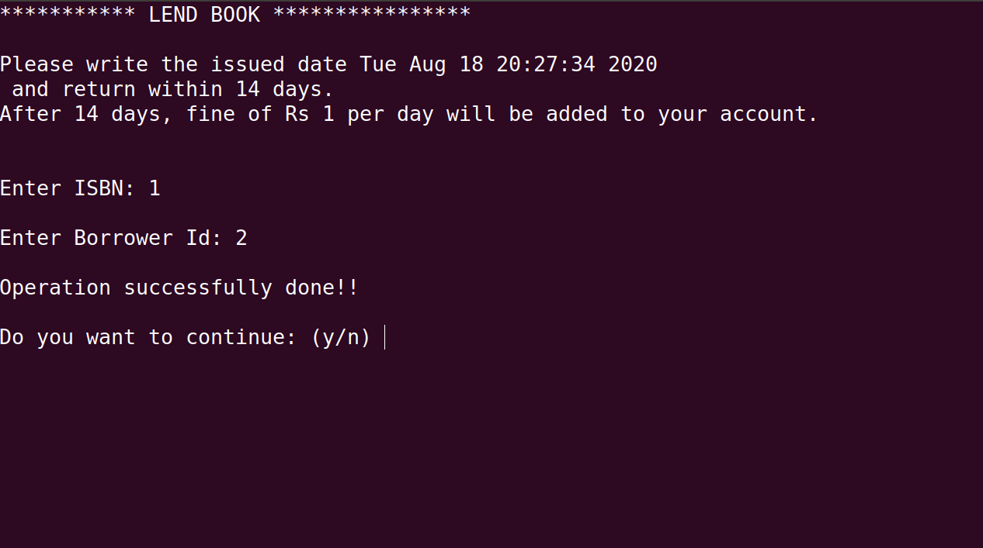
Lend Book Operation

Slide 18
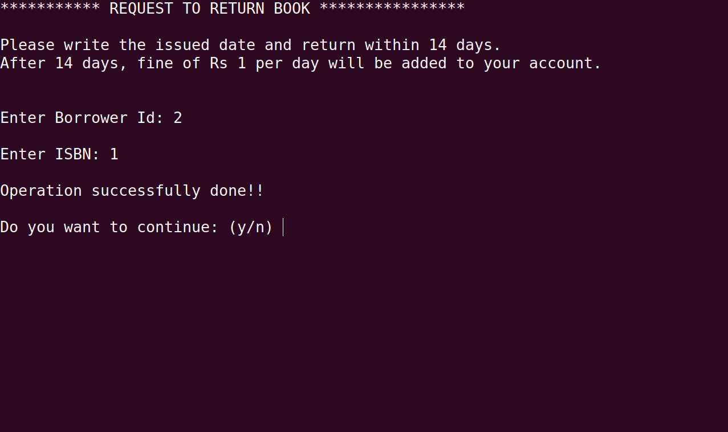
Return Book Operation

Slide 19
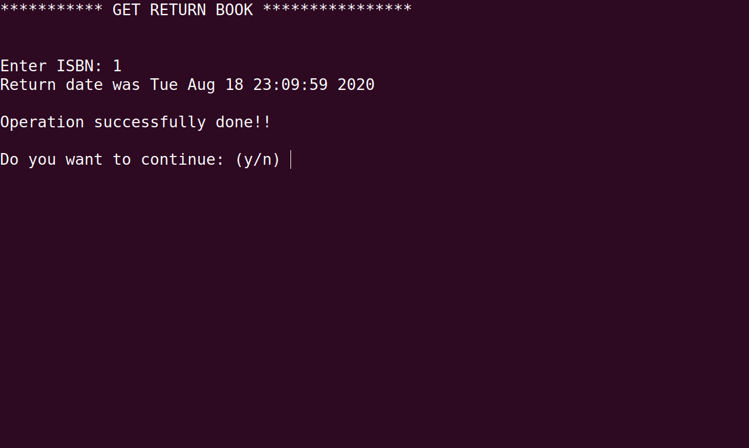
Get Return Book Operation

Slide 20
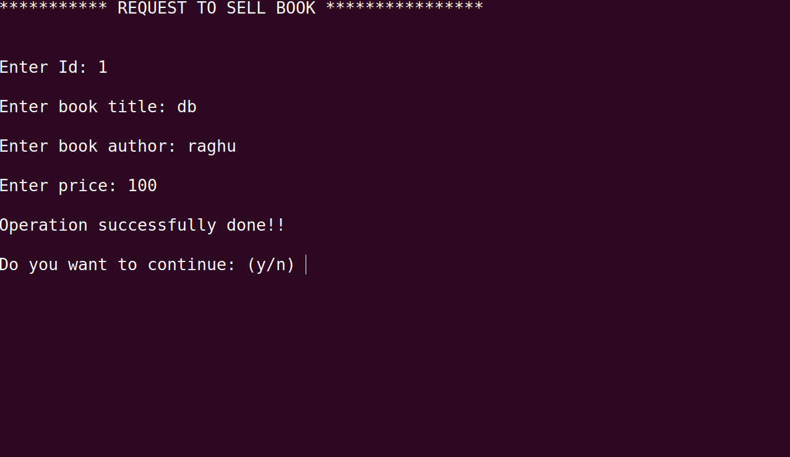
Sell Book Operation

